Slide 1
Inventory Management System
Created By Tirtharaj Sengupta
Tech-Stack : Node, MongoDB, express, passport.js, Ejs.

Slide 2
Running The application: Go to cmd/terminal of the folder
Development Server
npm run dev
Production Server
npm start

Slide 3
ROUTE DECLARATION(GET)
HTTP VERB | ACCESS | ROUTE, Name
GET | ALL | /, Home Page
GET | ALL | /login, Login Page
GET | ALL | /register, Registration Page
GET | ALL | /logout, Logout Route
GET | Admin, Seller | auth/dashboard, Dashboard Page
GET | Admin, Seller | auth/products, Edit Products
GET | Admin, Seller | auth/addProduct, Add Product Form
GET | Admin, Seller | auth/delete/:id, Delete Product
GET | Admin, Seller | auth/update/:update_id, Update Form
GET | All | auth/product-view-only, Show Products

Slide 4
Route Declaration(POST)
HTTP VERB | ACCESS | ROUTE, NAME
POST | ALL | /login, Login Route for Auth
POST | ALL | /registration, Registration Route
POST | Admin, Seller | /addProduct, Adding product Route
POST | Admin, Seller | /updateProductRoute/:_id, Updating Route

Slide 5
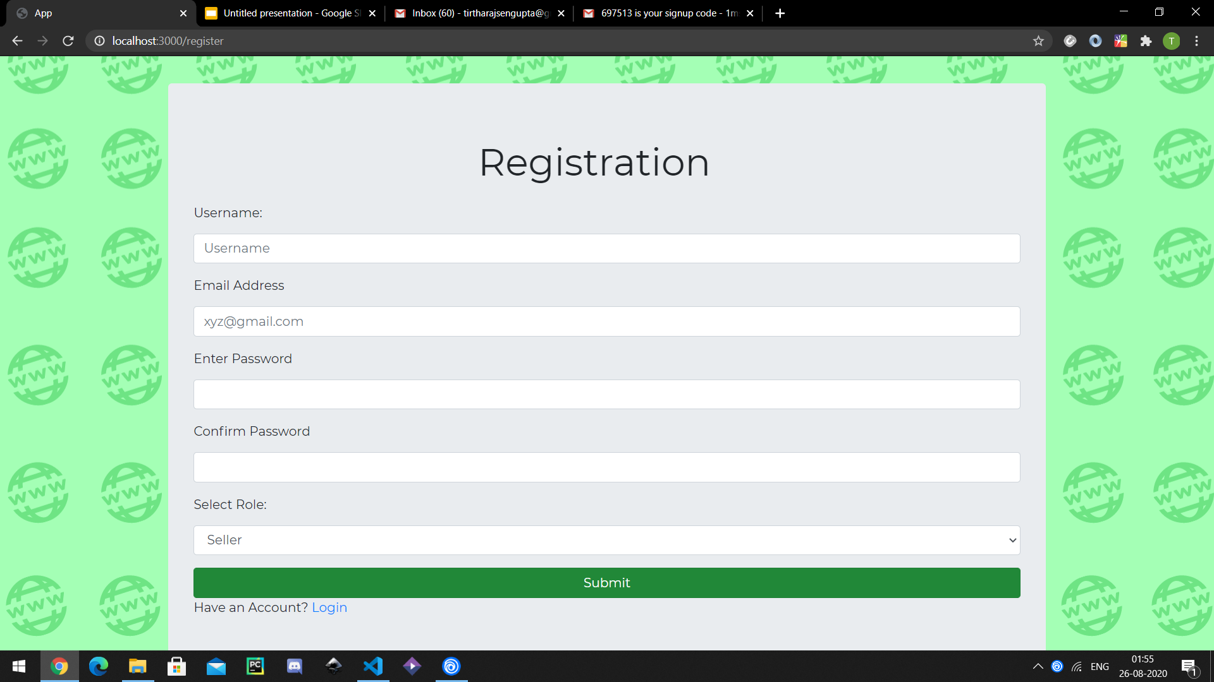
MAIN PAGES
1.Registration Page

Slide 6
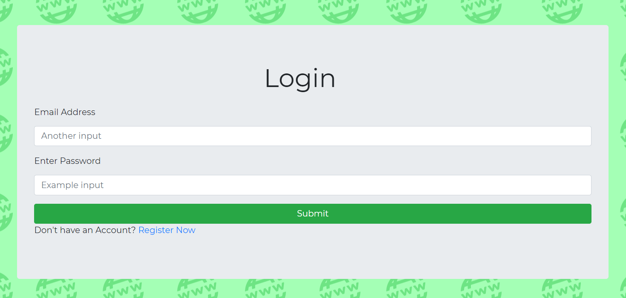
Main Pages
2.Login Page

Slide 7
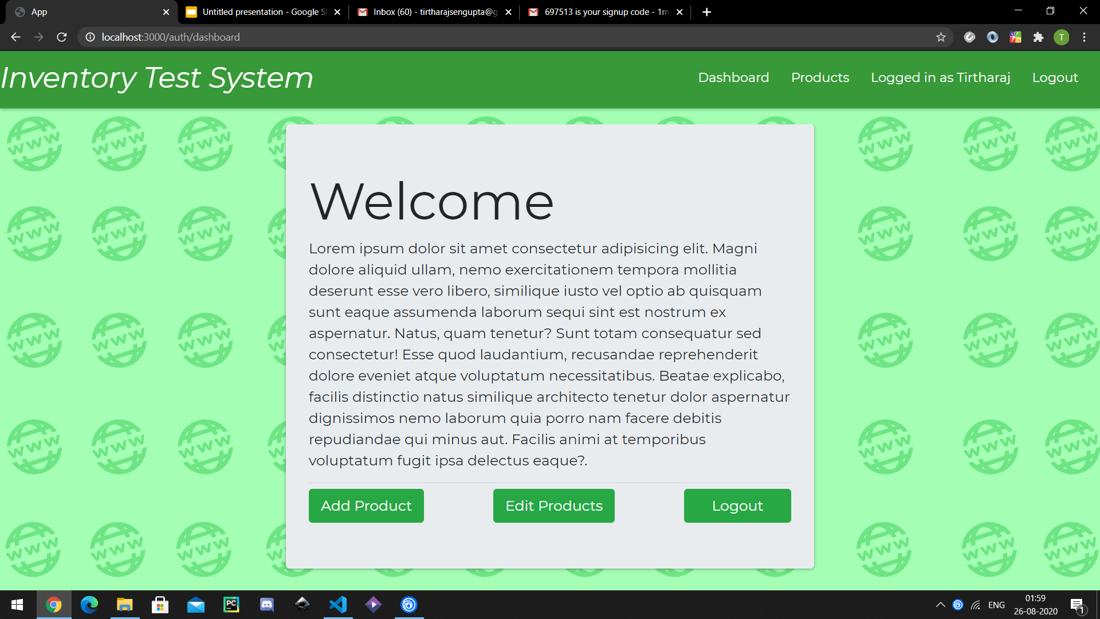
Main Pages
3.Dashboard Page

Slide 8
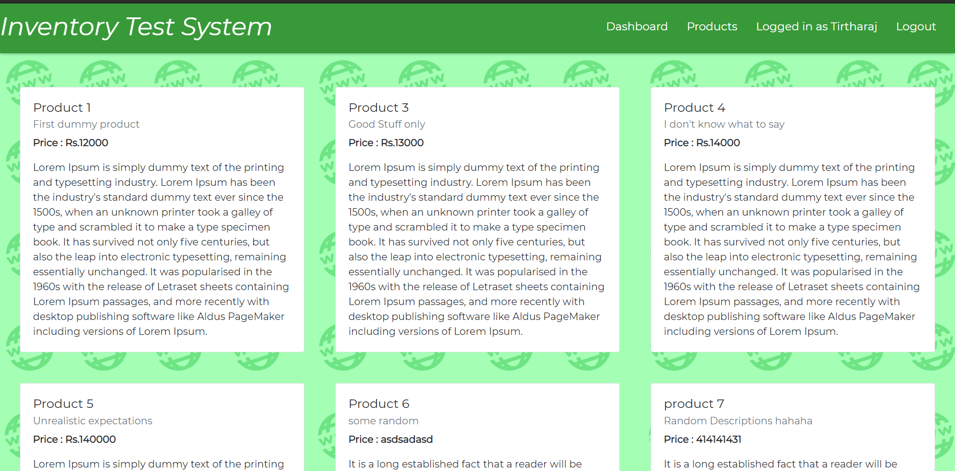
Main Pages
4.Product-View-Only

Slide 9
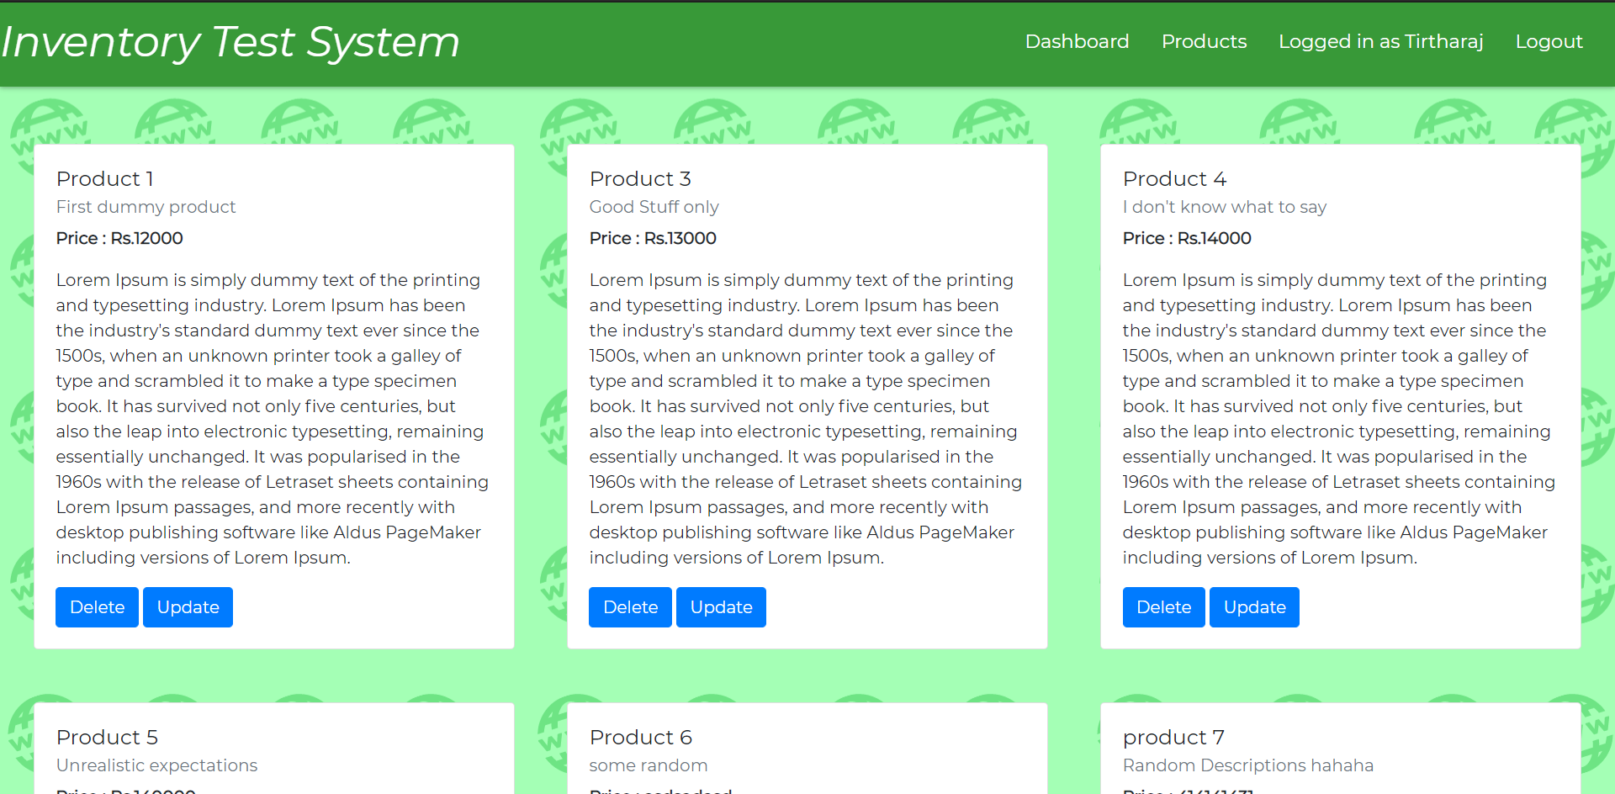
Main Pages
5.Product Editable(Specific to Sellers, ALL for Admins)

Slide 10
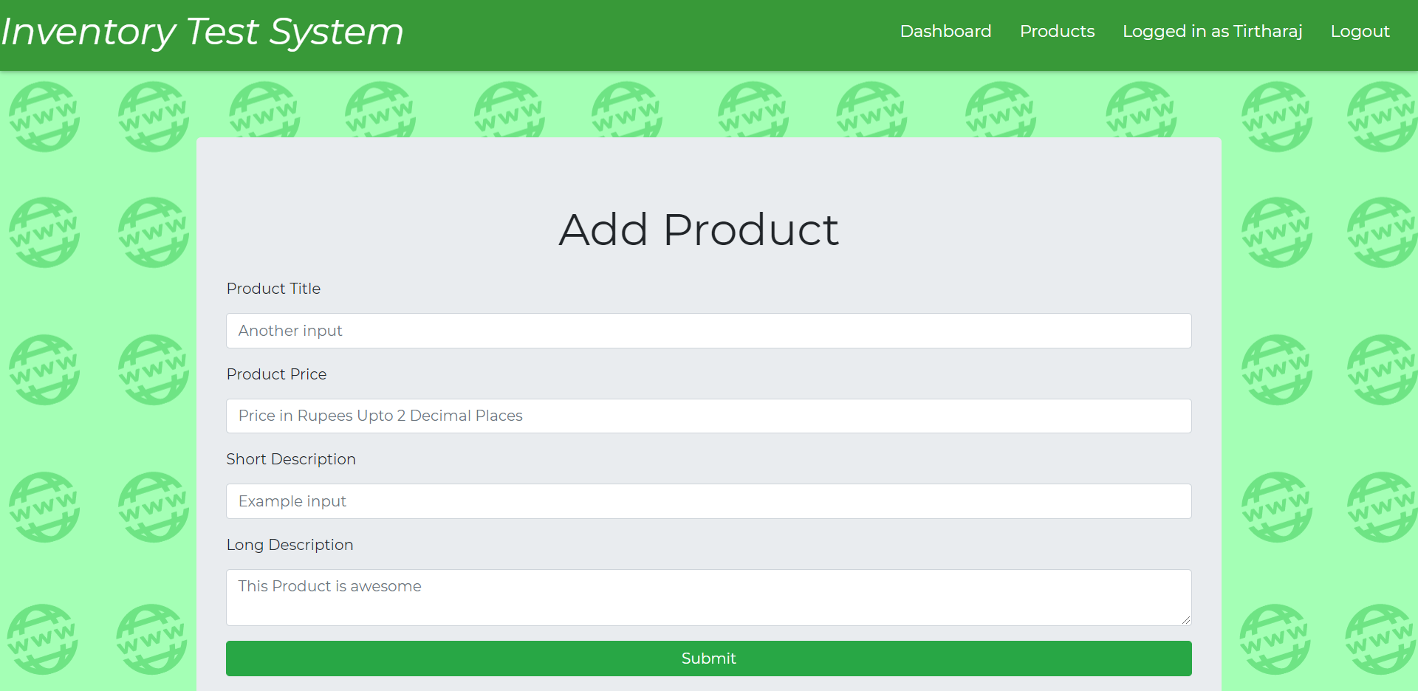
Extensions And Forms
1.Add Product

Slide 11
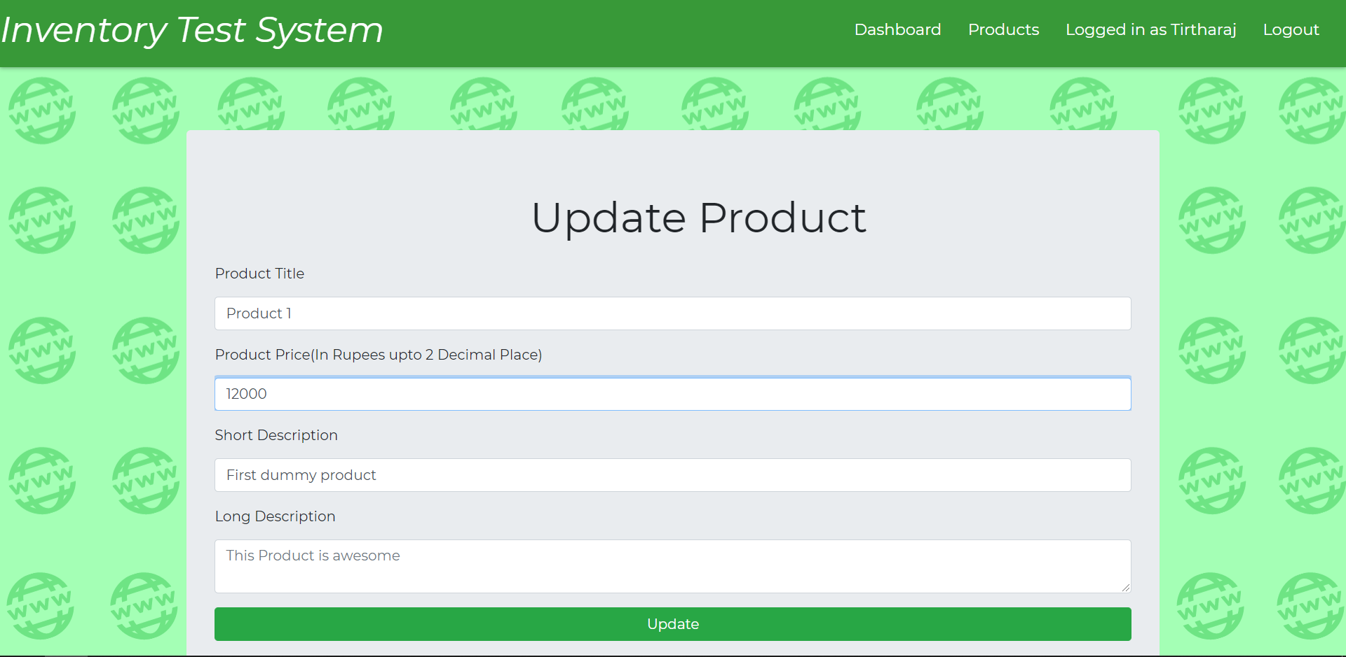
Extensions and Forms
2.Update Product

Slide 12
Authentication Strategy
Step 1: Email Validation
Check to see if email exists in database, return error if not found.
Compare password if email exists in database. The password is encrypted using bcryptjs with 10 salting rounds.
If password does not match, return error.
Pass Validation and redirect to products-view-only page if successful.
Errors to be shown in dismissable containers on the front end.

Slide 13
Roles and Auth Middleware
Roles:
Administrator : Has access to everything
Seller : Can edit their own products and view everything.
Customer : Can only view
Middleware:
forwardAuthenticated : checks if login is already completed. Redirects to products-view-only.
ensureAuthenticated : protects routes against unauthenticated access. Only registered users can access these routes.
isAuthorised : protects routes against unauthorised access. Only Admin and Sellers can access these routes.

